Slide 1


Smart wash

Slide 2
Team Overview
Mr. Denzil Barboza - Chief Executing Officer
B.E in Computer Engineering and Currently pursuing Master of Science degree in computer science at UF with specialization in databases.
Handles the decision making of the company and ensures other departments coordinate and work in the forward direction.
Mr. Karan Darekar – Chief Operational Officer
B.Tech in Civil Engineering and currently pursuing his Master of Science degree in Construction Management at UF.
Second highest authority in the company and is responsible for the efficient and smooth working of the company.
Mr. Swapnil Ghadge – Chief Finance Officer
B.E in Civil Engineering and currently pursuing his Master of Science degree in Construction Management at UF.
Has intricate knowledge of capital investment and is keen observer of current financial trends. He ensures the companies expenses are in control and profits are growing.
Mr. Chris Dume – Chief Marketing Officer
Currently pursuing his bachelor’s in Mechanical Engineering at UF.
Has special interest in marketing strategy development and advertising and he ensures the company is competitive in the market.
Mr. Akshay Wadettiwar – Chief Technology Officer
B.Tech in Civil Engineering and currently pursuing his Master of Science degree in Construction Management at UF.
Experienced in app development and he is the mind behind the coin laundry

Slide 3
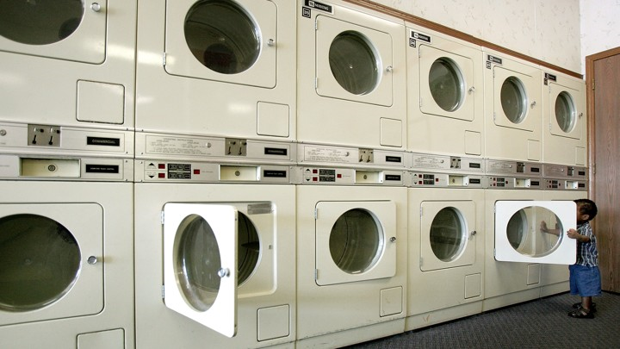
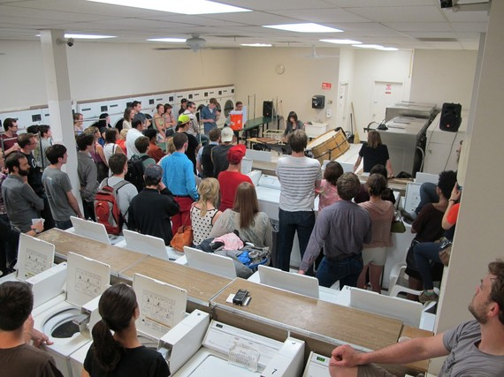
Coin Laundry
Coin laundry is defined as commercial-grade, self-service laundry equipment placed into service in a retail space.
The coin laundry industry is approximately 70 years old and is primarily composed of individual owners/operators.
Although many people choose to do their laundry at laundromats instead of purchasing a washers and dryers, they face a great deal of inconveniences such as:
long waiting times
out-of-order equipment
bad location
coin-only machines
no attendant on duty

Slide 4
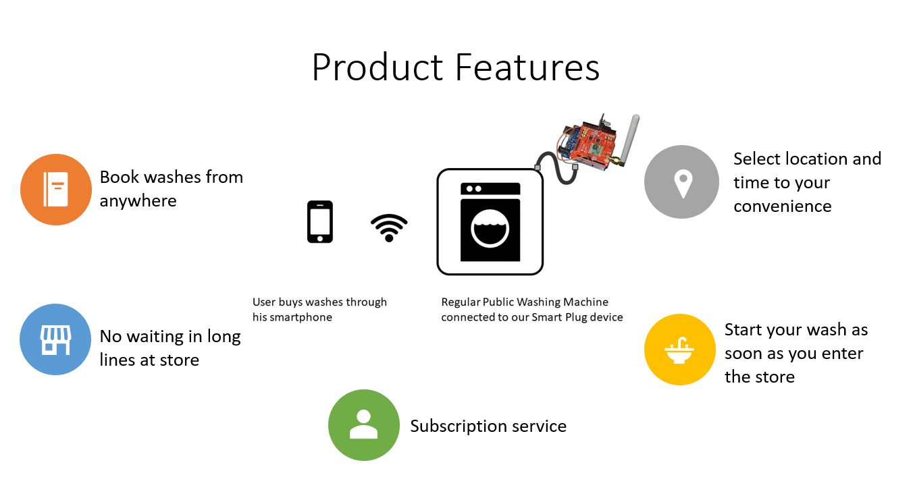
Solution Our solution is basically providing users(customers) with the power to choose their time, location and reserve a washer/dryer for themselves. This makes public laundry shops much accessible and open to the public. The idea is to develop a SmartPlug which will be installed at the nearest laundromats. This is a physical device that will be installed on site. This smart device will be connected to the internet to an application that the users will be having on their smartphones.

Slide 5
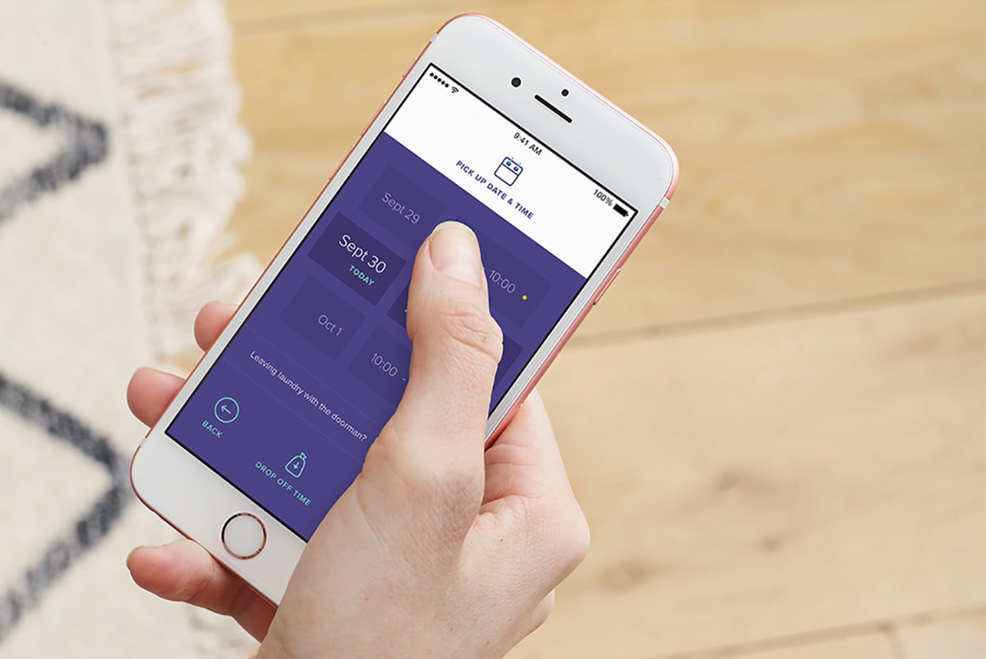
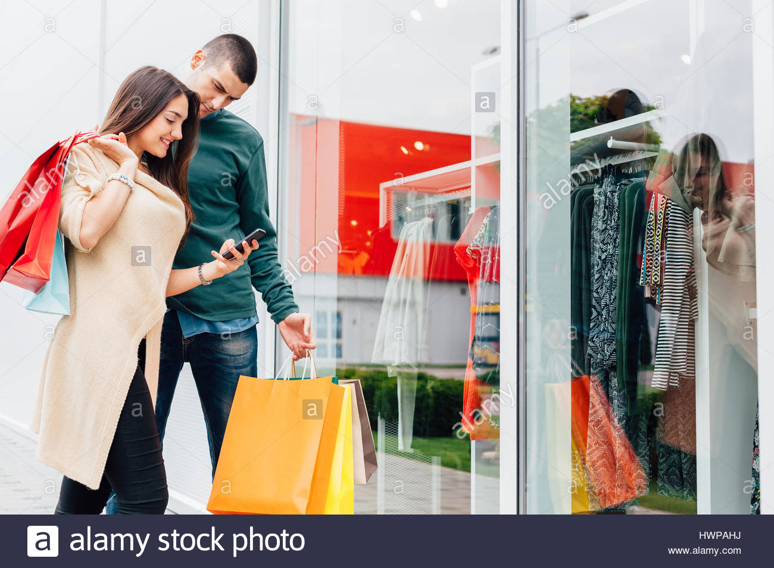
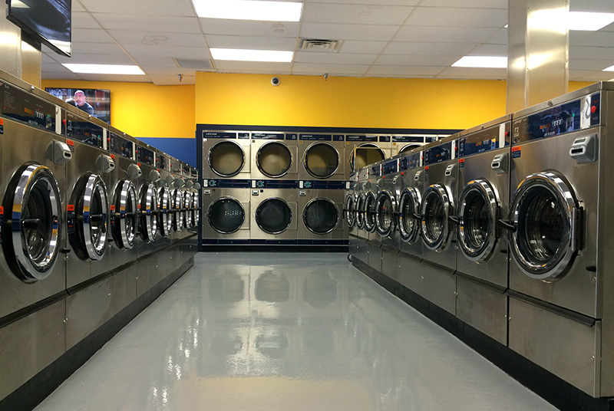
Value Proposition
Why we are better ?
No service like ours exists now in the united states
Public will be using the nearby already existing laundromat but in an advanced and cheaper way
Time is money and we save time
There are apps which enable digital payments but the only attempt to integrate laundry machine booking, payment and nearest store service is only provided by us
Our Goal :
To install our SmartPlugs in all laundromats across the country
Make laundry convenient and easy
How we will get there?
Selling the technology to laundromats
Using marketing to promote app downloads and usage
Building attractive subscription services

